Slide 1

Regulatory approval of the first biosimilar monoclonal antibody
Bruno Flamion, MD, PhD
University of Namur
Namur, Belgium
Past Chair of the European Medicines Agency (EMA) Scientific Advice Group

Slide 2
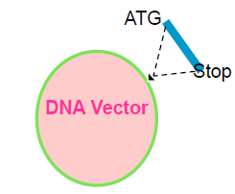

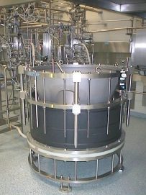
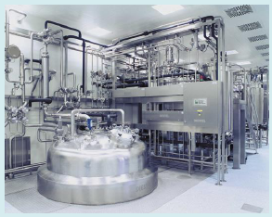
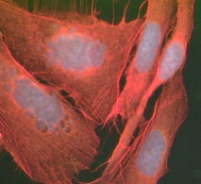
How to make a similar biological product?
Biologics have a complex manufacturing process that makes them difficult to copy; the end product is likely not to be the same as the originator
Coding gene mutation
Cloning into DNA vector
Transfer into host cell expression
Different purification and formulation protocols
Different cell culture processes
Dörner T, et al. Ann Rheum Dis. 2013;72(3):322-328.
Ahmed I. Clinical Therapeutics 2012; 34(2):400–419.

Slide 3
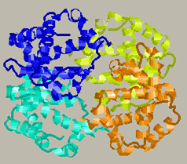
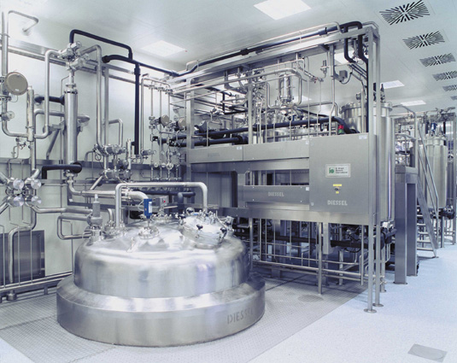
The complexity of biologicals
Inherent complexity
Size
Structure
Physicochemistry
Intrinsic heterogeneity
Additional complexity
Manufacturing process in living organisms
Formulation
Routes of administration
An exact copy is impossible to achieve
Courtesy of Betrand Coiffier.

Slide 4
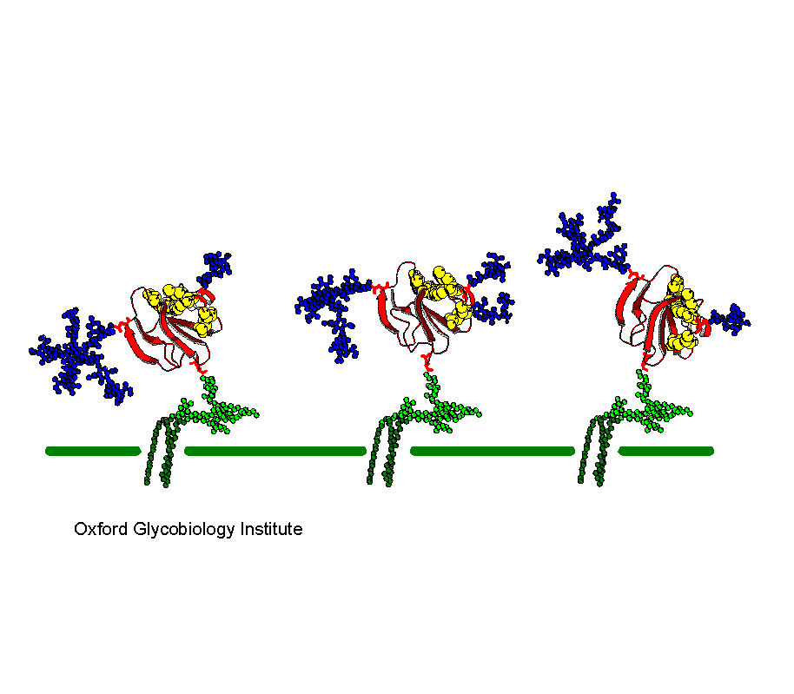
Intrinsic heterogeneity: e.g. glycoforms
Biologicals are microheterogeneous mixtures of several isoforms, each of which may differ in terms of potency, half-life, and immunogenicity
Rudd PM, et al. The glycosylation of the complement regulatory protein, human erythrocytes CD59. J Biol Chem. 1997;272(11):7229-7244.

Slide 5
How to get a biosimilar approved in the EU (EMA)
Overarching Guideline (CHMP/437/04).
“Guideline on Similar Biological Medicinal Products”
Defines principles
Quality
General guidelines
Quality / Safety Efficacy
Non-clinical
Clinical
Product class specific data requirements
LMWH
Insulin
Somatropin
G-CSF
Epoetin
IFN-α
IFN-β
FSH
Antibody
Non-clinical
Non-clinical
Non-clinical
Non-clinical
Non-clinical
Non-clinical
Non-clinical
Non-clinical
Clinical
Clinical
Clinical
Clinical
Clinical
Clinical
Clinical
Clinical
FSH, follicle-stimulating hormone; G-CSF, granulocyte colony-stimulating factor; IFN, interferon; LMWH, low-molecular-weight heparin
European Medicines Agency. Available at: http://www.ema.europa.eu/ema/index.jsp?curl=pages/regulation/general/general_content_000408.jsp. Accessed 25 September 2014.
Notes:
The EMA has published one “overarching” guideline on biosimilars and two guidelines describing the comparability exercise, at the quality level on one hand and at the non-clinical and clinical levels on the other hand. Nine specific guidelines are also available for specific classes of biosimilars: four classes where biosimilars have already been approved in Europe (somatropin, G-CSF, epoetins and alpha-FSH), four classes where biosimilars are expected in the near future (LMW heparins, insulin, and interferons alpha and beta) and one on therapeutic monoclonal antibodies in general. At this stage there is no guideline on specific monoclonal antibodies such as infliximab (one biosimilar approved in the EU), trastuzumab, rituximab, etc.

Slide 6
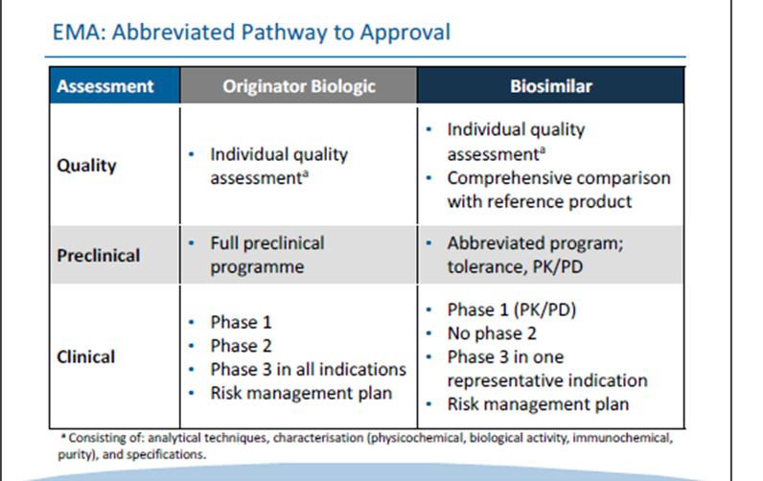
The EMA abbreviated pathway to approval
Notes:
This slide summarizes the EMA-approved abbreviated pathway for biosimilars applying for a marketing authorisation in Europe. This is also called a “comparability exercise” because a large part of the tests or clinical studies must be performed in comparison with one commercial batch of the originator. In brief, the abbreviated pathway does not allow any reduction on quality data (on the contrary, there is a comparative part) but does allow for a reduction in non-clinical and clinical data. This reduced need is indispensable for the concept of biosimilarity. It is the key trade-off. Without this prerequisite, a would-be biosimilar would have to follow a normal development plan and would be (almost) as expensive as the originator.

Slide 7
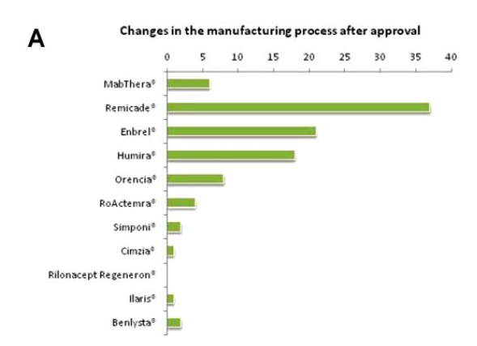
Comparability Exercise for existing products
Number of manufacturing changes approved for –mabs/-cepts in rheumatology
Schneider CK et al., Ann Rheum Dis 2013;72(3):315-318.
Physicochemical characteristics of subsequent products do not have to be identical but « highly similar »” (they may be slightly improved)

Slide 8
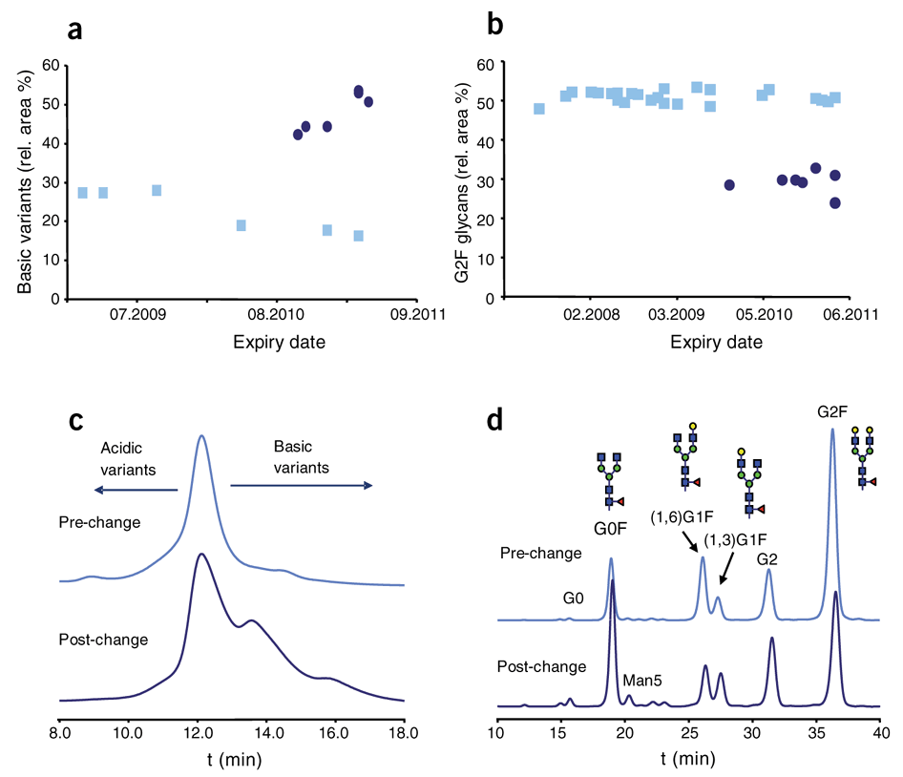
Comparison of Enbrel® batches before () and after ()
main manufactoring changes
Schiestl M, et al. Nature Biotech. 2011;29(4):310–312.

Slide 9
Comparability Exercise vs Biosimilarity
Comparability (change in manufacturing process) | Biosimilarity
Thorough internal knowledge by manufacturer | No internal knowledge
Extensive quality data Low need for clinical data | Extensive quality data High need for clinical data
Noninferiority tests | Therapeutic equivalence
If the comparison fails at any stage, the products cannot be declared biosimilar

Slide 10
Biosimilars at the European Medicines Agency (1)
1
1 Omnitrope (somatropin) Sandoz (Novartis) Authorized
2 Valtropin (somatropin) – [yeast] Biopartners Authorized
3 Alpheon (interferon alfa) BioPartners Negative
4 Binocrit (epoetin alfa) Sandoz (Novartis) Authorized
5 Epoetin alfa Hexal (epoetin alfa) Hexal (Novartis) Authorized
6 Abseamed (epoetin alfa) Medice Authorized
7 Silapo (epoetin zeta) Stada Authorized
8 Retacrit (epoetin zeta) Hospira Authorized
9 Insulin Marvel Short (human insulin) Marvel Life Sci Negative
10 Insulin Marvel Intermediate (human insulin) Marvel Life Sci Negative
11 Insulin Marvel Long (human insulin) Marvel Life Sci Negative
12 Filgrastim Ratiopharm (filgrastim) Ratiopharm Authorized
13 Biograstim (filgrastim) CT Arzneimittel Authorized
14 Tevagrastim (filgrastim) Teva Authorized
15 Zarzio (filgrastim) Sandoz (Novartis) Authorized
16 Filgrastim Hexal Hexal (Novartis) Authorized
17 Biferonex (interferon beta-1a) BioPartners Negative
18 Nivestim (filgrastim) Hospira Authorized
2006
2-withdrawn
2007
3
2007
4
2008
5
2009
6
2010
7
Notes:
1 & 2-Genotropin & Humatrope; 3 & 4-Eprex/Erypro; 5, 6 & 7-Neupogen (produced in E. Coli, not glycosylated)

Slide 11
Biosimilars at the European Medicines Agency (2)
MAb
In all indications !!
19 Remsima (infliximab) Celltrion Authorized
20 Inflectra (infliximab) Hospira Authorized
2013
8 **
9
21 Ovaleap (follitropin alpha) Teva Authorized
10
22 Gastrofil (filgrastim) Apotex Authorized
2014
Bemfola (follitropin alpha) Finox Biotech AG Authorized 11
24 Abasria (insulin glargine) Lilly-Boehringer Cleared CHMP 12
NB. At FDA: Basaglar (not a biosimilar – 505(b) procedure Cleared FDA
Biosimilars under evaluation
None at EMA – NB. Celltrion’s trastuzumab approved in N. Korea (January 2014)
August 2014: FDA accepted Sandoz’s Zarzio (filgrastim) application as a biosimilar
** Marketed in Norway, Portugal, Ireland, Finland, Eastern Europe; pending patent issues in other EU States
Notes:
1 & 2-Genotropin & Humatrope; 3 & 4-Eprex/Erypro; 5, 6 & 7-Neupogen (produced in E. Coli, not glycosylated)

Slide 12
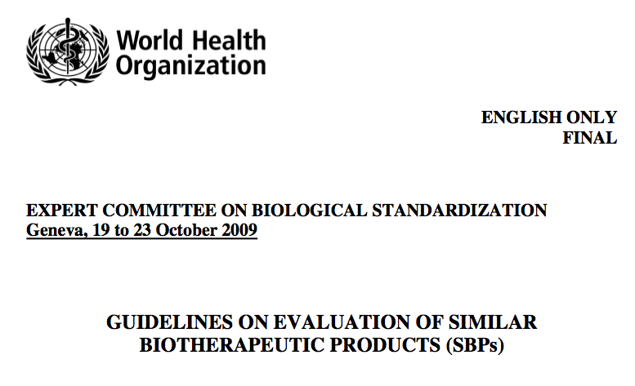
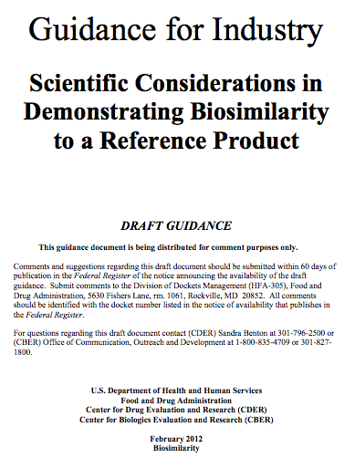
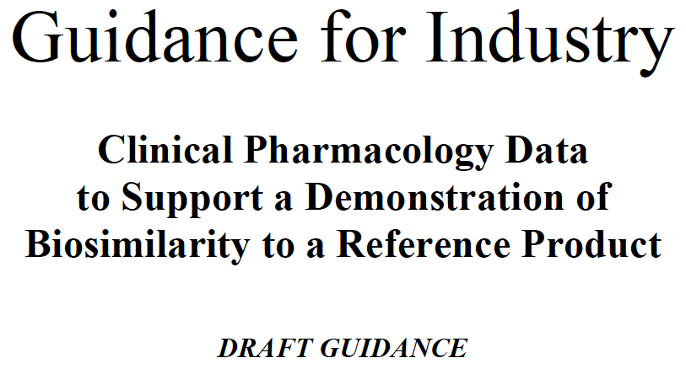
Biosimilars: other guidelines
2014
http://www.who.int/biologicals/areas/biological_therapeutics/en/. Accessed: 25 September 2014.
http://www.fda.gov/Drugs/GuidanceComplianceRegulatoryInformation/Guidances/ucm290967.htm. Accessed: 15 September 2014.

Slide 13
The contentious points
The debate on biosimilars

Slide 14

Without a reduction in regulatory requirements, the biosimilar concept is not (economically) tenable
How can regulatory requirements be reduced without undue risks (unacceptable loss of efficacy, or unexpected immunogenicity)?

Slide 15
Methods agreed by regulators to reduce regulatory requirements for biosimilars
Accurate PK studies (if possible, PK/PD data)
2. Fewer patients but enough statistical power to detect differences:
  more homogenous population
  “in principle, the most sensitive endpoints”
  sufficiently large equivalence margins (➙ leads to some additional uncertainty)
Extrapolation of (many) indications

Slide 16
Phase III: which population, which endpoints ?
« In principle, the most sensitive disease model to detect differences in both efficacy and safety should be used in a homogeneous patient population to reduce variability. »
➙ In oncology, that would mean response rate rather than (overall) survival, possibly in early-stage patients; it would also mean immunocompetent subjects
But clinicians expect the most relevant population…

Slide 17
Justification for extrapolation of indications
According to EMA
Case by case (according to guideline if there is one)
Sufficient clinical experience
Consistent scientific literature
Similar mechanism of action in the extrapolated indications: target/receptor localisation and expression; binding affinity; concentration-response relationship…)
PK/PD & biodistribution data
Expected adverse events in various indications
Expected immunogenicity in various indications

Slide 18

Results From CT-P13 Phase III Equivalence Trial
N = 606. Primary efficacy endpoint:ACR20 response at week 30
Safety: Treatment-emergent adverse events were seen in 35.2% of patients treated with CT-P13 and 35.9% of patients treated with INX
Immunogenicity: Equivalent levels of anti-infliximab antibodies were detected in both treatment arms at week 14 and week 30
100 –
90 –
80 –
70 –
60 –
50 –
40 –
30 –
20 –
10 –
0 –
Treatment difference =
4% (95% CI: -4%, 12%)
Treatment difference =
2% (95% CI: 6%, 10%)
73.4
CT-P13
69.7
60.9
58.6
INX
184/302
178/304
182/248
175/251
ITT Population
PP Population
Yoo DH, et al. Ann Rheum Dis. 2013;72(10):1613-1620.

Slide 19
Evolution of Remicade (EU): Efficacy
Fistulizing
CD maintenance
Moderate/
Severe
Psoriasis
RA:
joint damage
Crohn’s
Disease
Ankylosing
Spondylitis
Psoriatic
Arthritis
1999
2000
2001
2002
2003
2004
2005
2006
RA: signs
and symptoms
Luminal CD
maintenance
Ulcerative
Colitis
RA:
physical function
Early RA
Basis for extrapolation of indications for Remsima®, together with PK data in AS
+ Post-approval commitment for a Ph III trial in Crohn’s disease
CD, Chron’s disease

Slide 20
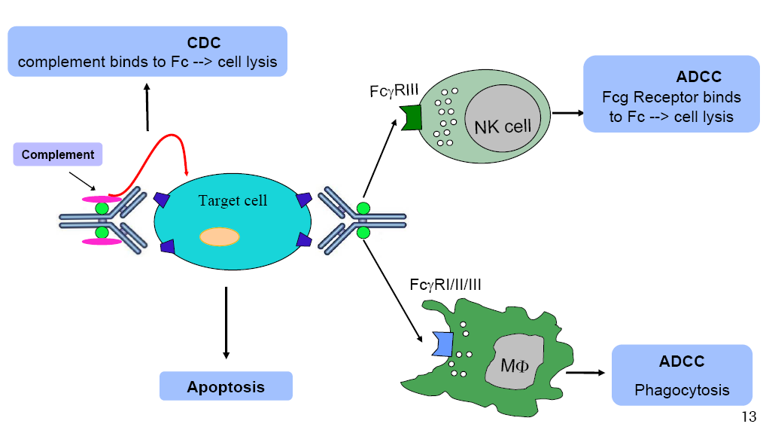
Biosimilar mAbs
Biosimilar monoclonal antibodies (mAbs): the clinical issues are not different from other biosimilars but “technically” are we pushing the concept too far?
Very complex mechanism of action
Very complex production
Complex (oncology) indications

Slide 21
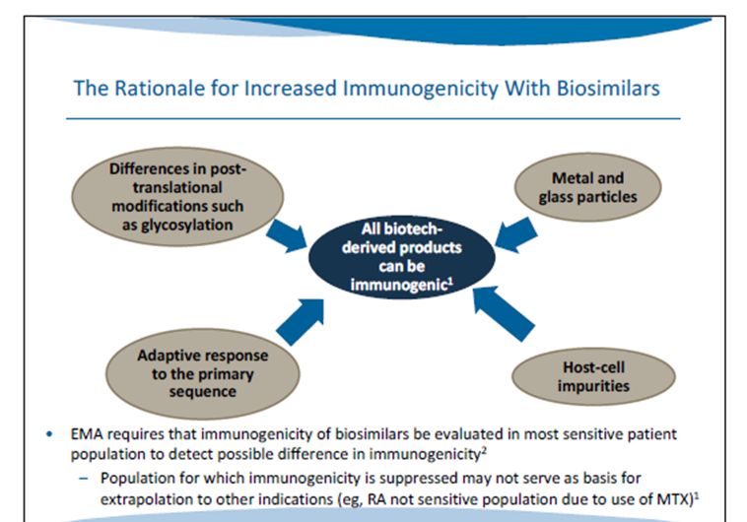
Increased immunogenicity of biosimilars?
EMA/CHMP. Guideline on similar biological medicinal products containing biotechnology-derived proteins as active substance: non-clinical and clinical issues. Available at: http://www.ema.europa.eu/docs/en_GB/document_library/Scientific_guideline/2009/09/WC500003920.pdf. Accessed 25 September 2014..
Notes:
BF TEXT. Unexpected, Increased immunogenicity is undoubtedly the major safety concern with biosilmilars. As explained previously, any change, any difference in the composition or proportion of isoforms in the biological mixture that makes up the biosimilar versus the originator may create unexpectedly high levels of anti-drug antibodies or even hypersensitivity reactions. The latter are rare but could be life-threatening. Anti-drug antibodies are more insidious as they can progressively block the action of the therapeutic protein, a result that is difficult to detect at the individual level. How do you know if a drug has stopped acting or if the disease has become resistant to that particular product? This is why the measurement of blocking ADAs using up-to-date technology is so important and is requested by the authorities.

Slide 22
Immunogenicity & traceability
Immunogenicity in humans cannot be predicted from animal data → absolute need for comparative clinical trials including tests for neutralizing Abs and PK/PD data
Consider the risk to the endogenous protein
How long?
Usually 1 year prelicensing if chronic use is intended; the subsequent risk management plan (RMP) is crucial
➙ Interchangeability ?
➙ Traceability (and naming) of biosimilars
➙ Should be prescribed under brand names

Slide 23
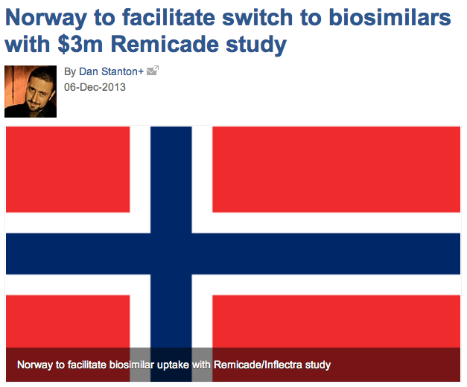
Recent initiative towards interchangeability
NOR-SWITCH study
800 patients
Will start recruiting in October 2014

Slide 24
Some Take-Home Messages

Slide 25
Take-home messages (1)
The biosimilarity concept means a “low likelihood of clinically significant differences”
According to (EU) regulators, a product can be biosimilar only if it has successfully gone through the stepwise (Q/S/E) “comparability exercise” (regulatory oversight)
Therefore, not all copies of biological products worldwide can be declared “biosimilar”

Slide 26
Take-home messages (2)
The focus of the clinical part of the biosimilar exercise is on PK/PD and dose-concentration-response relationships using sensitive populations and endpoints, it is not on patient benefit per se
Extrapolation of indications is key to the biosimilar concept but needs to be justified in all cases
Several “relatively simple” biosimilars have been approved. The application of the biosimilar concept to mAbs in oncology is a leap forward

Slide 27
Take-home messages (3)
Detection of immunogenicity and a good risk management plan are key elements of safety — so far there has been no safety issue with any biosimilar
Traceability should be ensured by prescribing under brand names
Interchangeability is a national (or local) issue
10. How much “reassurance” are decision makers and clinicians willing to give away in favor of lower prices?

